Slide 1
Are We There Yet
Progress Report 3

Slide 2
What's been done
SRS Submitted
Sprint 1 post-mortem
Sprint 2 backlog created

Slide 3
What we’re working on
Initial system design
Initial parts list
Research

Slide 4
What’s next
Budget
Parts list
System design

Slide 5
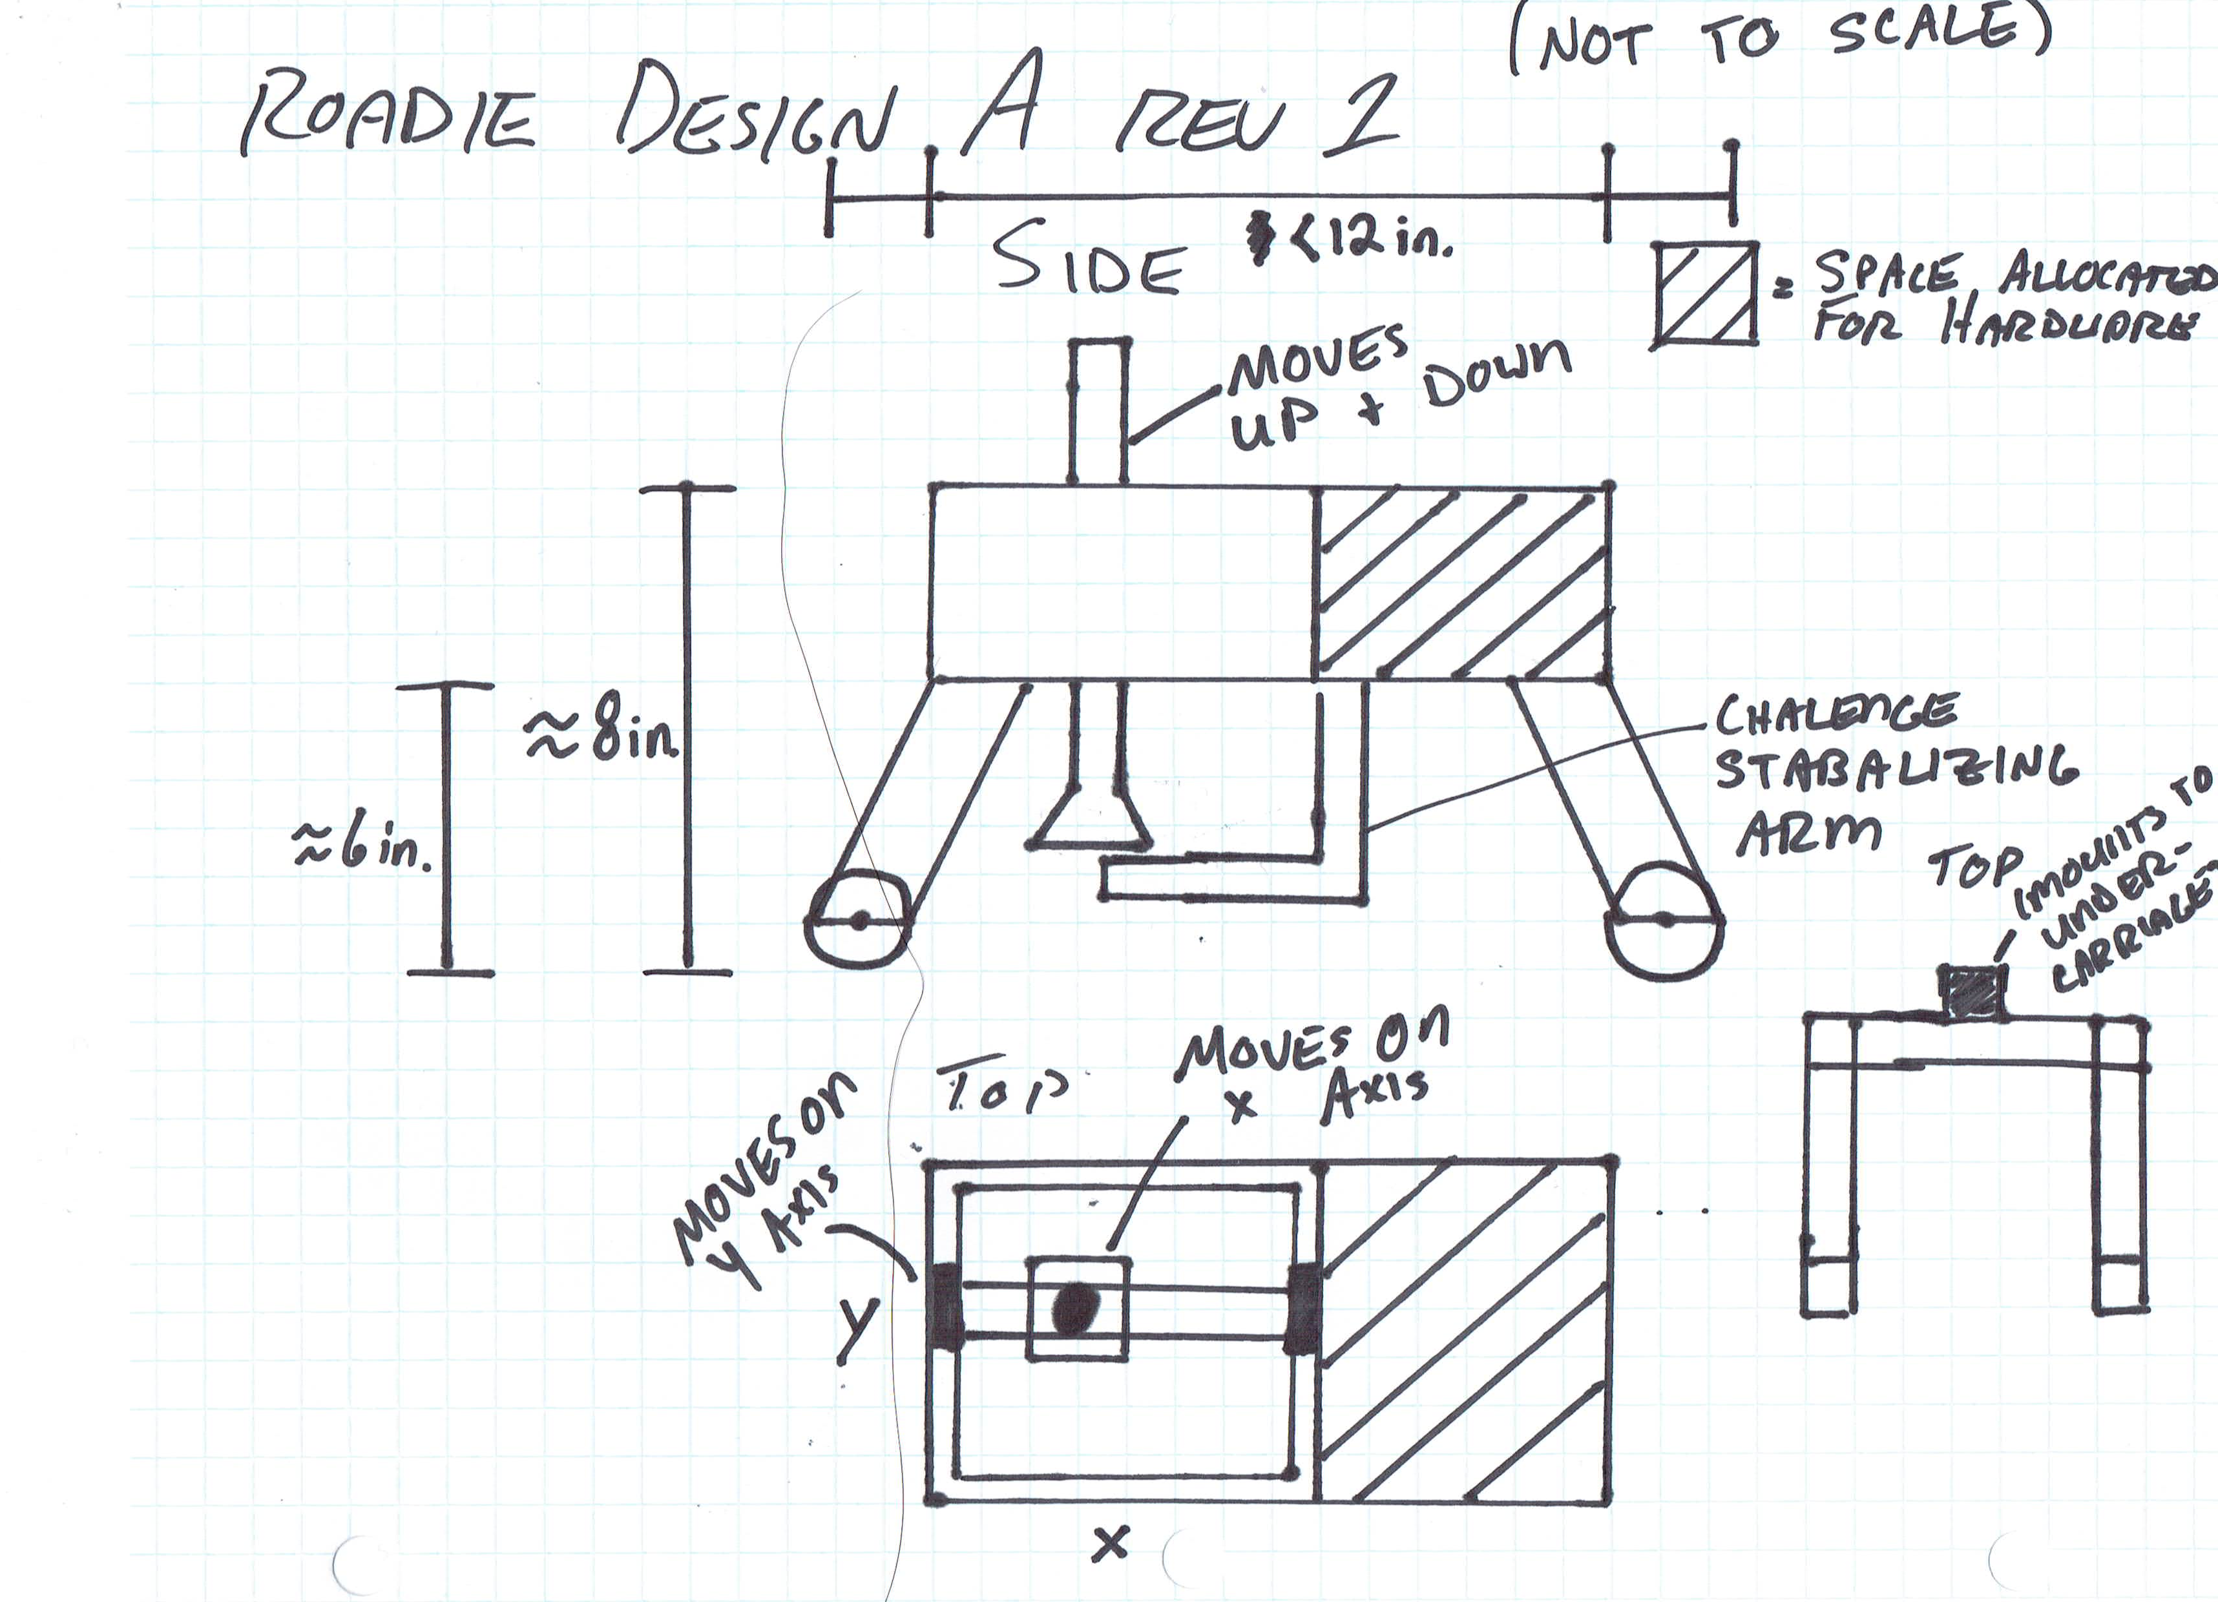
Design A: Rev 1

Slide 6
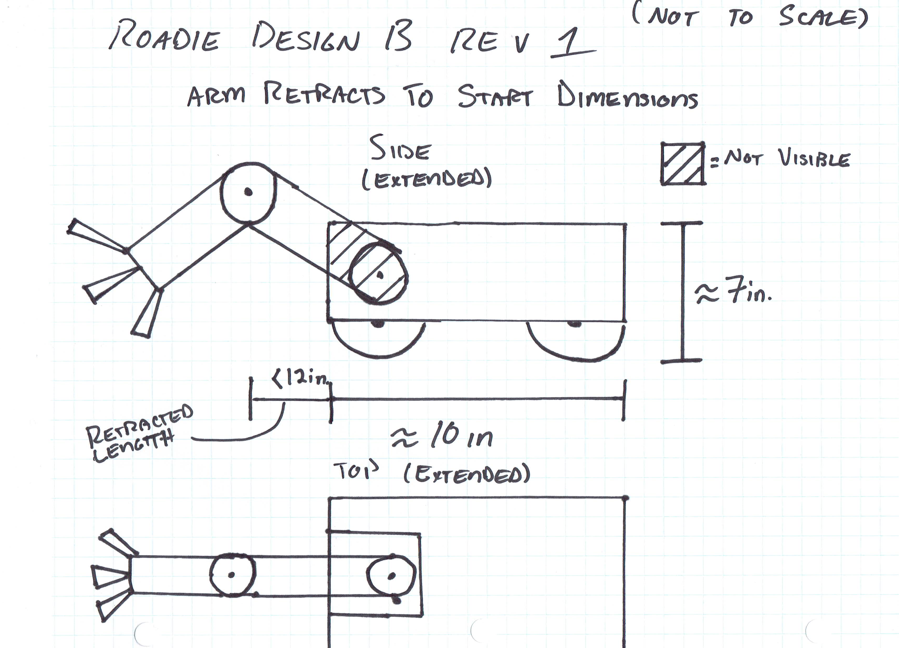
Design B: Rev 1

